Slide 1
Performance is a Feature in .NET
presented by: Mark Rendle
for: Copenhagen Developers' Festival
28th August 2023

Slide 2
Roadmap
Project
Performance?
Profiling
Benchmarking
Performance Testing (CI)
Production Monitoring
Q & A

Slide 3
Me

Slide 4
Workshop Project
github.com/RendleLabs/CPHDF23

Slide 5
Docker stuff
docker compose pull

Slide 6
Performance?

Slide 7
Performance?
Elapsed time
CPU time
Perceived time
Scalability

Slide 8
Selling Performance

Slide 9
Selling Performance
User Experience
Productivity
Competitive Edge

Slide 10
Valuing Performance
Twice as fast?

Slide 11
Valuing Performance
Twice as fast?
Half the resources

Slide 12
Valuing Performance
Twice as fast?
Half the resources
Server instance size or count
Serverless runtime

Slide 13
UfoWeb

Slide 14
Stopwatch

Slide 15
Optimizing Logging

Slide 16
HttpClient

Slide 17
HttpCompletionOptions
ResponseContentRead
ResponseHeadersRead

Slide 18
Caching

Slide 19
Caching
In-Memory
Microsoft.Extensions.Caching.InMemory
Distributed
e.g. Microsoft.Extensions.Caching.StackExchangeRedis

Slide 20
MessagePack

Slide 21
Profiling

Slide 22
Profiling Tools
dotTrace & dotMemory (JetBrains)
dotnet trace
Visual Studio 2022
ANTS Profiler (Redgate)
PerfView

Slide 23
Profiling
Launch app
Trigger activity (warm-up)
Attach Profiler
Trigger activity
Stop Profiler

Slide 24
Benchmarking

Slide 25
BenchmarkDotNet
benchmarkdotnet.org
Framework for performance-testing small bits of code
Diagnose Memory, GC, IL and more

Slide 26
Performance Testing

Slide 27
BenchmarkDotNet + XUnit
Assert against performance
Works with your Unit Test framework
Prevent performance regressions in CI

Slide 28
Load Testing

Slide 29
Load Testing Tools
JMeter (Java)
NBomber (.NET)
Locust (Python)
k6 (Go)

Slide 30
k6
https://github.com/grafana/k6/releases

Slide 31
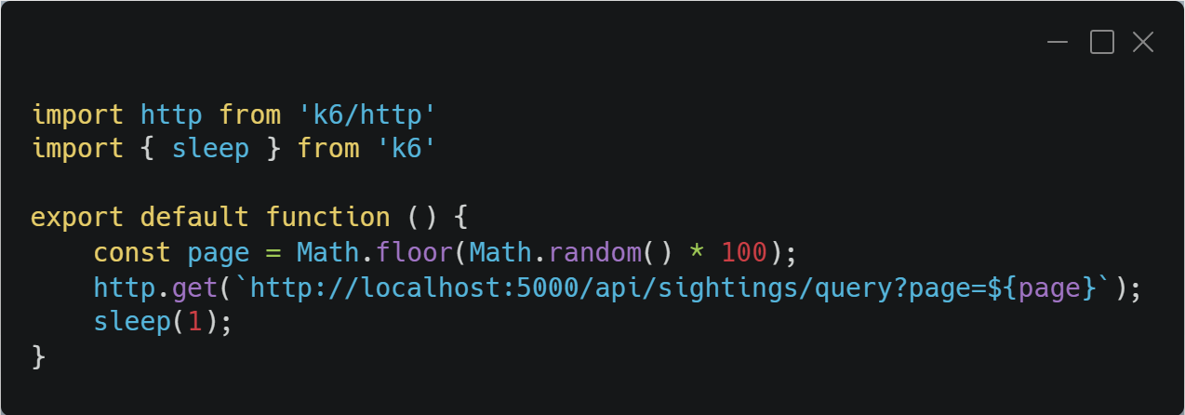

Slide 32
Monitoring

Slide 33
Metrics
Metrics:
Counters
Histograms
Gauges

Slide 34
Distributed Tracing
Trace requests across multiple operations & nodes
Drill down
OpenTelemetry
opentelemetry.io
Jaeger
jaegertracing.io

Slide 35
OpenTelemetry

Slide 36
Native AOT

Slide 37
Native AOT
AOT == Ahead Of Time
Self-contained native executable
(Much) Faster startup times
No runtime code generation
Minimal API only in .NET 8.0

Slide 38
Performance Tips

Slide 39
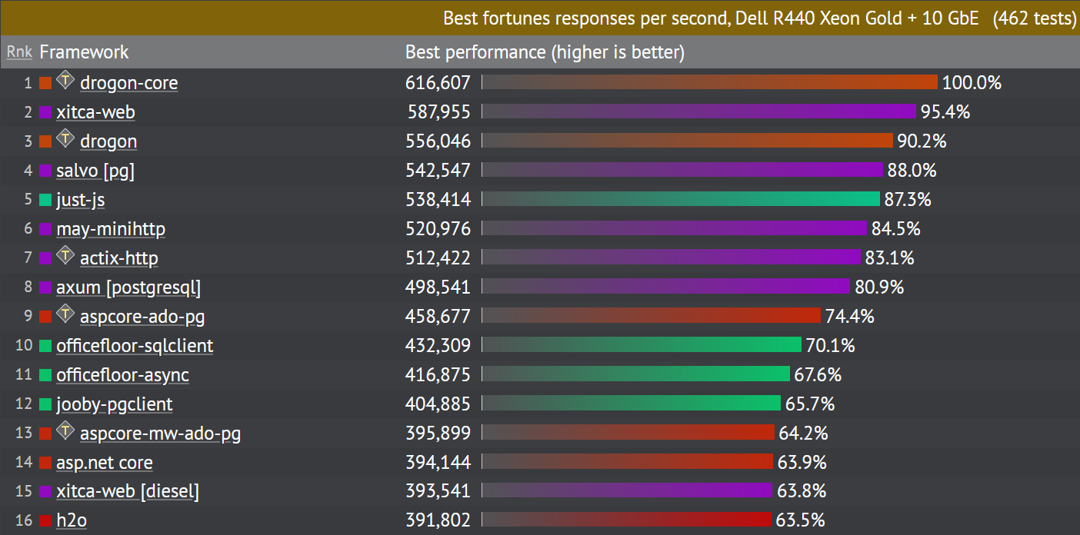
.NET is Fast
https://www.techempower.com/benchmarks/#section=data-r21&test=fortune

Slide 40
Garbage Collection
Avoid unnecessary Heap Allocations
Especially Strings
Object Pools
Pre-boxing
Always be using using
Server vs Workstation

Slide 41
Strings
StringBuilder
string.Create
ReadOnlySpan<char>

Slide 42
structs
readonly struct
avoids defensive copying
ref struct
always passed by reference
in parameters
by reference, readonly

Slide 43
Pools
ArrayPool<T>
Microsoft.IO.RecyclableMemoryStream
ObjectPool<T>
StringBuilder

Slide 44
Server vs Workstation
Server for small number of processes, e.g. dedicated VM per app
Workstation for large number of processes, including Containers

Slide 45
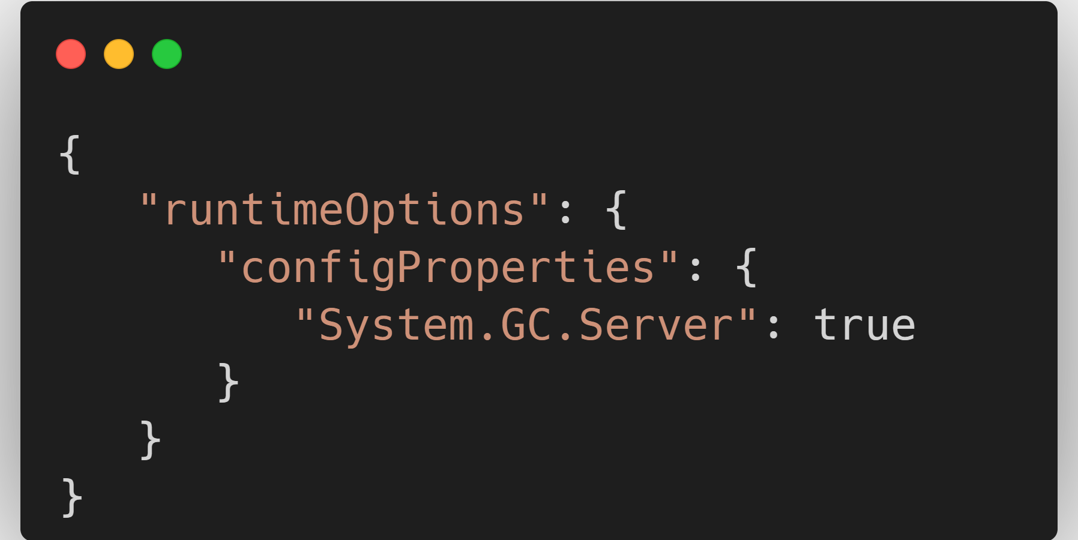
runtimeconfig.json

Slide 46
Miscellaneous

Slide 47
LINQ
Avoid LINQ on super-hot paths

Slide 48
EF Core
AddDbContextPool
Disable Tracking
builder.UseQueryTrackingBehavior
context.ChangeTracker.QueryTrackingBehavior
query.AsTracking / query.AsNoTracking

Slide 49
HttpClient
DO NOT DISPOSE
Use IHttpClientFactory where possible

Slide 50
Caching
InMemoryCache
Distributed Caching
Redis
NCache
SQL Server
In Memory*

Slide 51
CommunityToolkit.HighPerformance
SpanOwner<T> / MemoryOwner<T>
StringPool
ParallelHelper

